Slide 1



Humanitarian Program (Humanly)

Slide 2
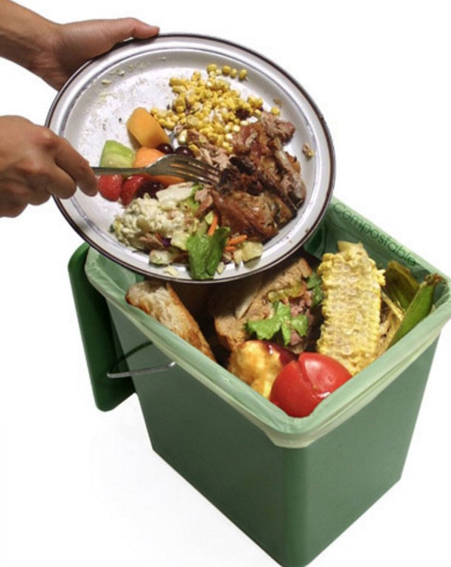
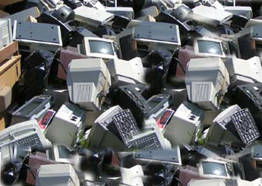
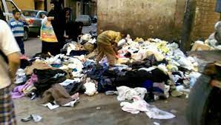
Problem statement
The food, clothes, and appliances are used, among the most important blessings. But what happens is that the surplus of bait, used clothes, and some devices are put in the landfill after they are finished, where others need them, but we do not feel them. We have created this website to facilitate access to the needy and to give and help them with some of what God has bestowed upon us.

Slide 3

Brief about the project
A project to help the needy with some things that we don't need and they need.

Slide 4
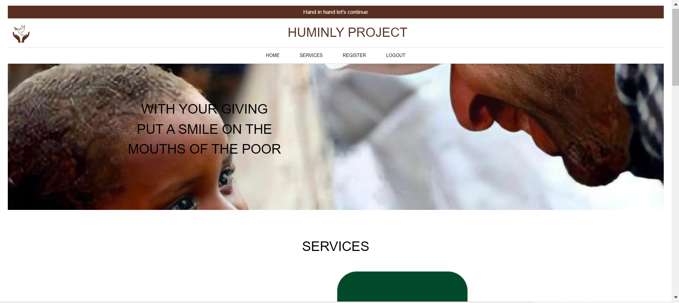
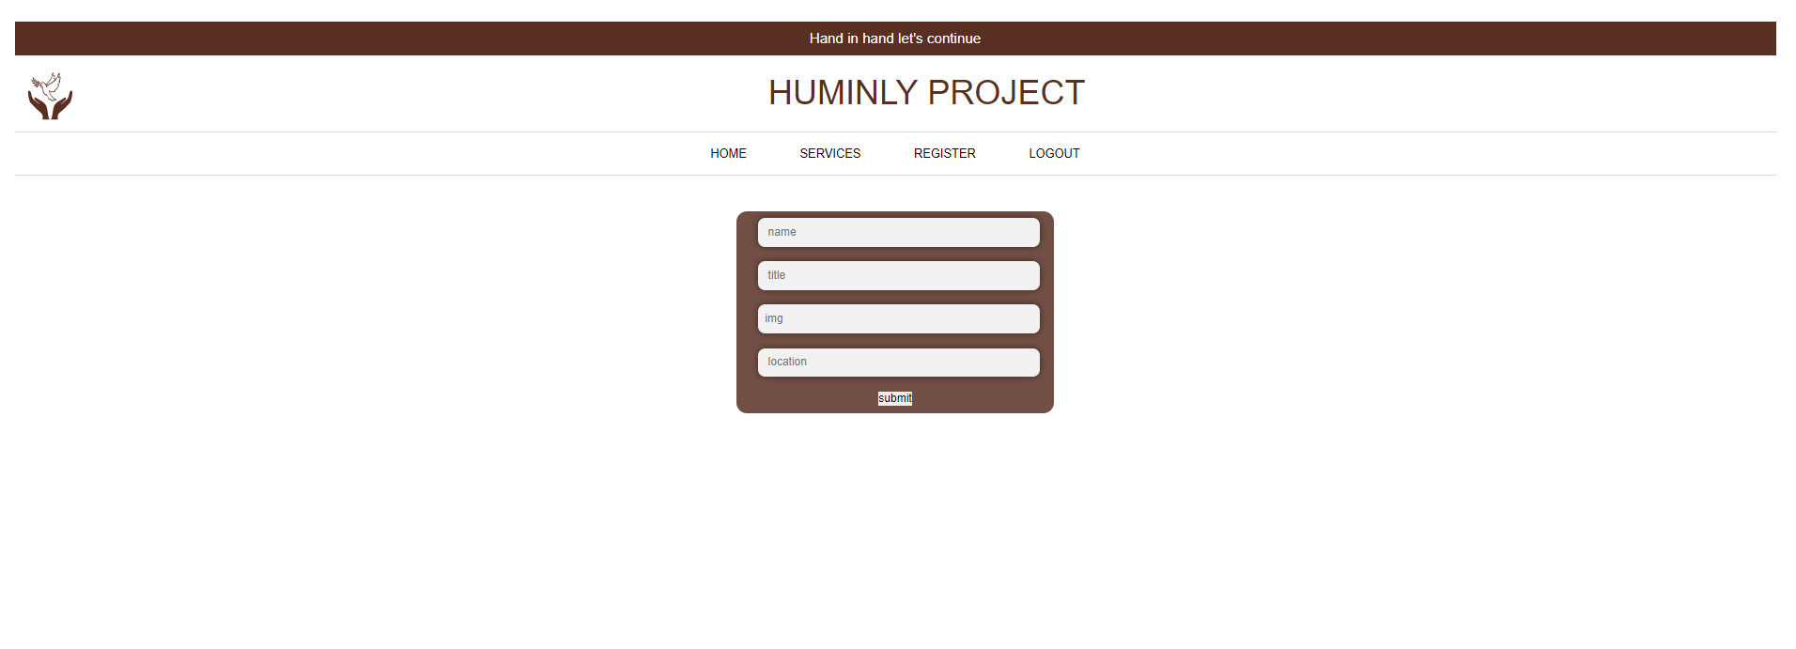
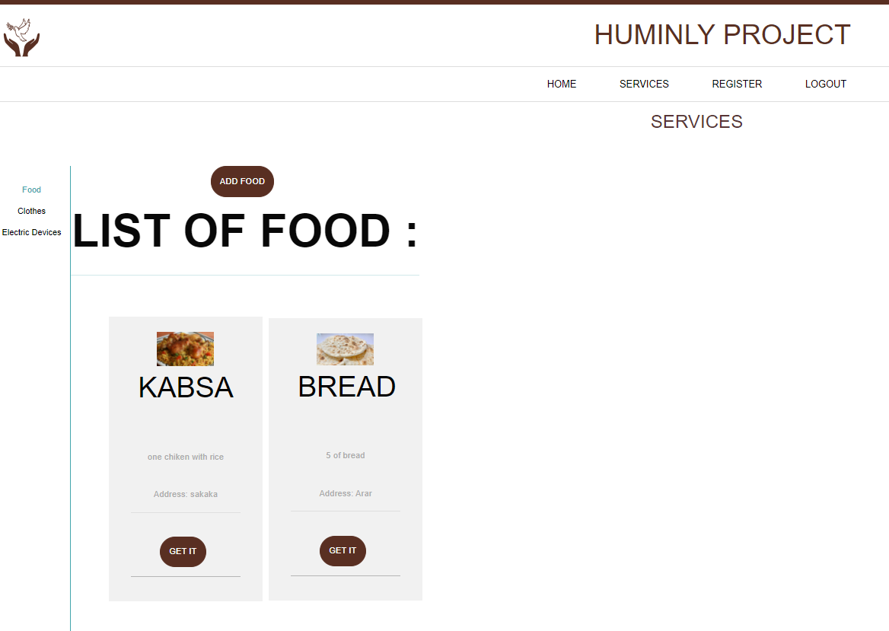
The beginning of the project will show you the interface of the site and an overview of its goal
After registering in it and logging into your account, you can enjoy our services and be able to add your donation of food, clothes and some equipment, or take what you need from charity services

Slide 5
Made it using java language : FrontEnd: 1- visual studio 2- spring boot 3-React BackEnd: 1- intellij 2- mysql

Slide 6
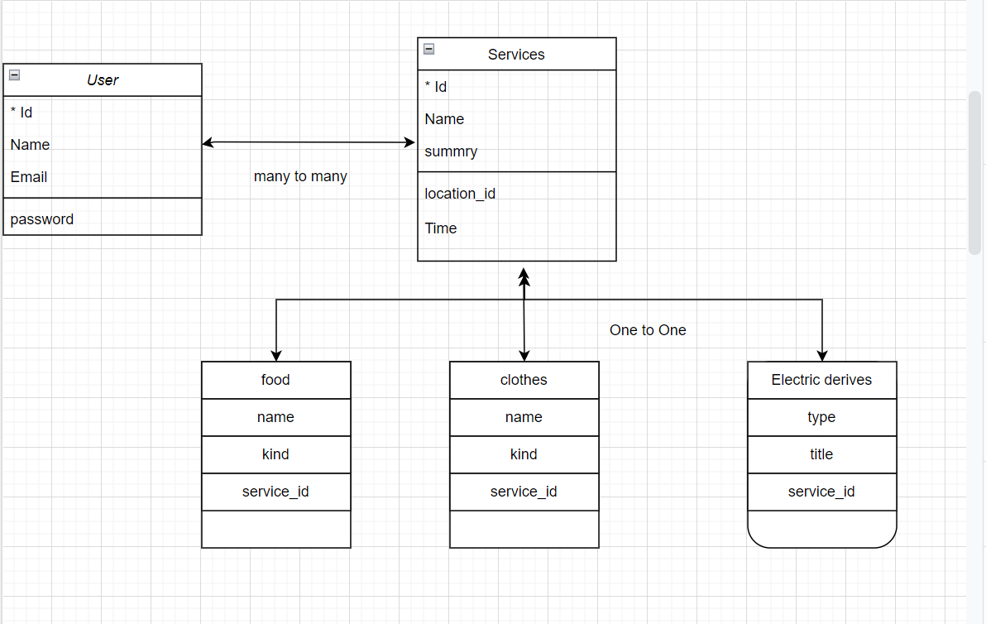
Diagram:

Slide 7
-About the most difficult part of the project:
Designing the database was a little hard.
-About favorite part of the project
As for my favorite part, it was the frontend, page design and css

Slide 8
The new things I learned: The new things that I learned from creating this app are linking backend with frontend and linking tables to each other in various ways

Slide 9
Thank you

